Slide 1
Developing a Digital Engagement Funnel
THE LEADER’S CIRCLE

Slide 2
How do you interact with infrequent customers or attenders who don’t seem to be embracing your mission the way you hoped they would? It’s simple. You embrace them anyway.
THE LEADER’S CIRCLE

Slide 3
Attendance alone doesn’t produce devoted disciples.
THE LEADER’S CIRCLE

Slide 4
If you want to grow, stop trying to attract people and start trying to engage them.
THE LEADER’S CIRCLE

Slide 5
The goal of digital content is connection, not consumption.
THE LEADER’S CIRCLE

Slide 6
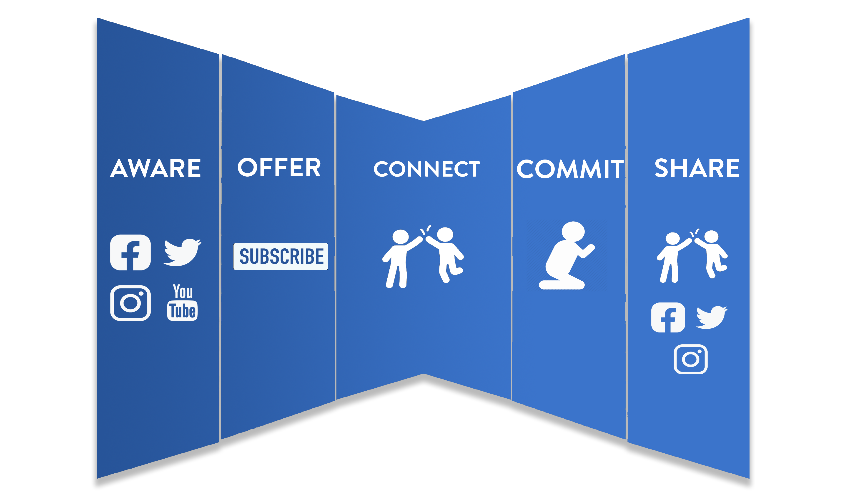
Digital Engagement Funnel
THE LEADER’S CIRCLE

Slide 7
When presenting your offer, you want to give people something of extreme value. Here are some examples of offers that I’ve used:
- Checklists
- Video series
- E-Books
- Cheat Sheets
THE LEADER’S CIRCLE

